Slide 1


Karthiga Thangavelu
5/23/2023

Slide 2

Outline
Executive Summary
Introduction
Methodology
Results
Conclusion
Appendix

Slide 3
Executive Summary
Summary of methodologies
Data collection
Data wrangling
EDA (Exploratory Data Analysis) with SQL
EDA (Exploratory Data Analysis) with visualization
Interactive dashboard using folium
Interactive dashboard using Dash
Predictive analysis
Summary of all results
EDA SQL and visualization results
Interactive map results
Predictive analysis result

Slide 4
Introduction
Project background and context
In this project, the successful landing of Falcon9 rocket is predicted. SpaceX’s Falcon9 rocket launch costs 62 million dollars, whereas other rockets launces costs upward 165 million dollars. Because SpaceX reuse the first stage of the rocket launch. Therefore, determining the success of first stage landing, the cost of launch can be predicted. This information can be used in alternate company to bid against SpcesX.
Problems you want to find answers
The features that are useful for prediction of success rate of first stage of rocket launch and the correlation between each features.
Best model with high accuracy that classifies success and failure rate of first stage of rocket launch.
How features such as payload mass, launch outcome, orbit type, and number of flights affect the outcome of the first stage.

Slide 5

Section 1

Slide 6
Methodology
Executive Summary
Data collection methodology:
Data are collected requesting data from API in JSON format and converting to table. Also, it can be collected through web scrapping.
Perform data wrangling
Filter the data, dealing with missing values, adding classes and one hot encoding the values
Perform exploratory data analysis (EDA) using visualization and SQL
Perform interactive visual analytics using Folium and Plotly Dash
Perform predictive analysis using classification models
Build and tune the model using sklearn python library and confusion matrix is used as a evaluation metrics

Slide 7
Data Collection
Describe how data sets were collected.
You need to present your data collection process use key phrases and flowcharts

Slide 8
Data Collection – SpaceX API
The data are collected from URL in JSON format. Then JSON is normalized to table.
Rocket, payloads, launchpad, and cores are the field which contribute to the outcome of the rocket launch result. So, these filed are extracted and converted to Dataframe.
Only the Falcon9 rocket are extracted for prediction. These data are pre-processed
https://github.com/karthigat/SpaceY-s-new-rocket-launch-prediction/blob/main/Collecting%20Data.ipynb
Request data from URL using requests library and store it in a variable response
The response are in JSON and are to be normalized to table
Extract only the field that are required and filter out Falcon9 data
Set the label based on outcome of the rocket launch

Slide 9
Data Collection - Scraping
Using web scraping, the data can be scarped from web page directly.
The data from Falcon9 Launch page is scarped using beautiful soup.
Then the table in scraped data are extracted and added to created dictionary.
The dictionary is then converted to Dataframe.
https://github.com/karthigat/SpaceY-s-new-rocket-launch-prediction/blob/main/Webscraping.ipynb
Get URL using requests library
Use beautiful soup and extract text
Find table and extract data
Get URL using requests library

Slide 10
Data Wrangling
Dataset
In data wrangling the null values and datatypes are analyzed
The bad outcomes which failed in land, ocean, and from ship are assigned to 0 and successful launches are assigned as 1.
https://github.com/karthigat/SpaceY-s-new-rocket-launch-prediction/blob/main/Data%20Wrangling.ipynb
Analyze datatypes and null values
Assign 0 to bad outcomes and 1 to successful launches

Slide 11
EDA with Data Visualization
The charts were plot between Payload Mass vs Flight Number, Launch Site vs Flight Number, Payload Mass vs Launch Site, Flight Number vs Class, Flight Number vs Orbit, Payload Mass vs Orbit, Date vs Class,
The scatter plot is used for finding the relationship between the two features that contribute to the outcome of launches.
The bar chart is used for the success rate of each orbit where it is plotted between flight number and class.
https://github.com/karthigat/SpaceY-s-new-rocket-launch-prediction/blob/main/EDA%20with%20Visualization.ipynb

Slide 12
EDA with SQL
For sql magic function is used to query the table.
Display unique launch site
Display launch site starts with CCA
Display total payload mass and average payload mass
Select the first landing of success on ground and select success on drone for payload mass between 4000 and 6000
Select the success outcome and the booster versions
Select the launches that are in the year 2015 and landing outcome between 2010 and 2017.
https://github.com/karthigat/SpaceY-s-new-rocket-launch-prediction/blob/main/Spacex_SQL_data.ipynb

Slide 13
Build an Interactive Map with Folium
Folium makes it easy to visualize data. The circles in map object is used to highlight circle area on a specific coordinates. The circle is to show the launch site of rocket.
Marker are created to specify the location, marker cluster are used to group the location, and marker_color is used to differentiate between success and fail of the launch. The marker are added to visualize launch site of rocket.
In line, polyline are used to show the line between the coastal region and the launch site.
https://github.com/karthigat/SpaceY-s-new-rocket-launch-prediction/blob/main/Interactive%20Map%20with%20Folium.ipynb

Slide 14
Build a Dashboard with Plotly Dash
In dashboard pie chart, slider, and scatter plot are added to dashboard. The drop down has the launch site.
Pie chart are to see success and failure rate of rocket launch for each site. Slider gives the minimum payload and maximum payload.
Scatter plot is between launchsite and payloads.
https://github.com/karthigat/SpaceY-s-new-rocket-launch-prediction/blob/main/dashboard_plt.py

Slide 15
Predictive Analysis (Classification)
Split test and train
Assign parameters such as C, penalty as l2 , and solver as lbfgs
Split the dataset into test and train. Set the parameter such as C, penalty, and solver.
Using the GridSearchCV to choose the best model for training.
Linear regression, SVM, Decision Tree, and K-Nearest Neighbor are the algorithms used for training rocket launch and find the best model based on accuracy.
You need present your model development process using key phrases and flowchart
https://github.com/karthigat/SpaceY-s-new-rocket-launch-prediction/blob/main/Prediction.ipynb
Find the best params and score
Use logistic regression, tree decision, svm, and knn
Predict the successful landing and plot the confusion matric
Compare all 4 models score and find the best model to predict based on accuracy

Slide 16
Results
Exploratory data analysis results
Interactive analytics demo in screenshots
Predictive analysis results

Slide 17

Section 2

Slide 18
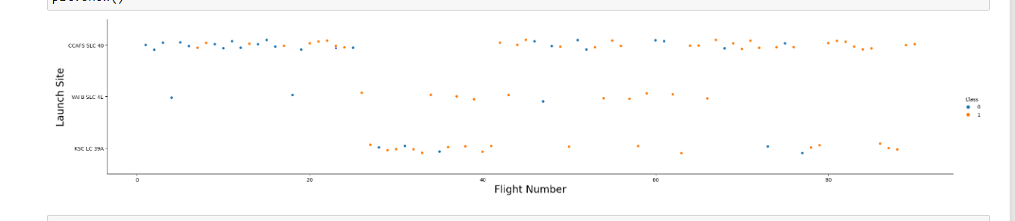
Flight Number vs. Launch Site
Explanation:
Launch site CCAFS SLC 40 with earliest flight has lot of failed attempts than later flights.
VAFB SLC 4E has few flight attempts where most of the flights are successful
Similarly, KSC LC 39A has most of the successful landing in later flights.

Slide 19
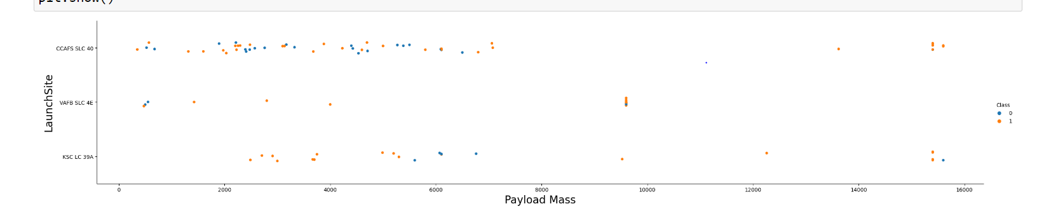
Payload vs. Launch Site
Explanation:
CCAFS SLC 40 has high success rate for payload mass over than 8000
VAFB SLC 4E has high success rate for payload mass over than1500
KSC LC 39A launch site has between 2000 and 5000

Slide 20
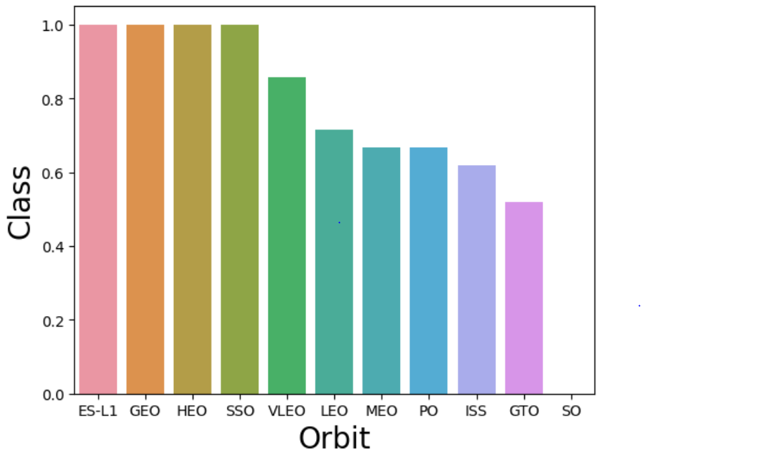
Success Rate vs. Orbit Type
Explanation:
The orbit type ES-L1, GEO, HEO, SSO has high success rate.
The other orbit type VLEO, LEO, MEO, PO, ISS, GTO has success rate between 85 and 55 percentage

Slide 21
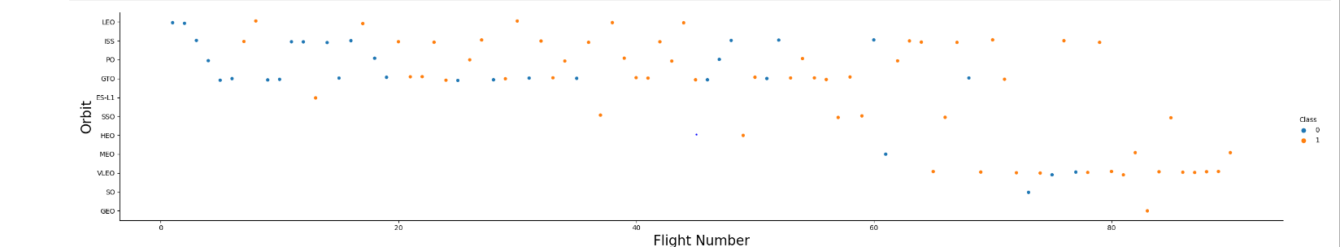
Flight Number vs. Orbit Type
Explanation:
LEO, ISS, and PO success rate are high when the flight number is high
GTO has 50% success and 50% failure for flight number
ES-L1, SSO, MEO, HEO, and VLEO has high success rate for higher flight number

Slide 22
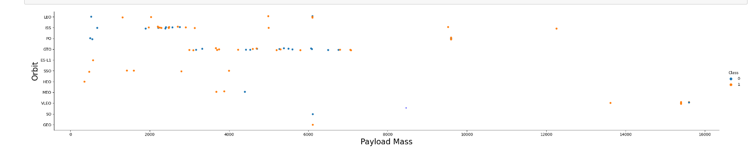
Payload vs. Orbit Type
Explanation:
For LEO, ISS, PO, and GTO success rate is higher for higher fight number
For GTO the success and failure rate fall between flight number 3000 and 7000
For ES-L1, SSO, HEO, and MEO lower the flight number higher the success rate and they lie between 0 and 6000

Slide 23
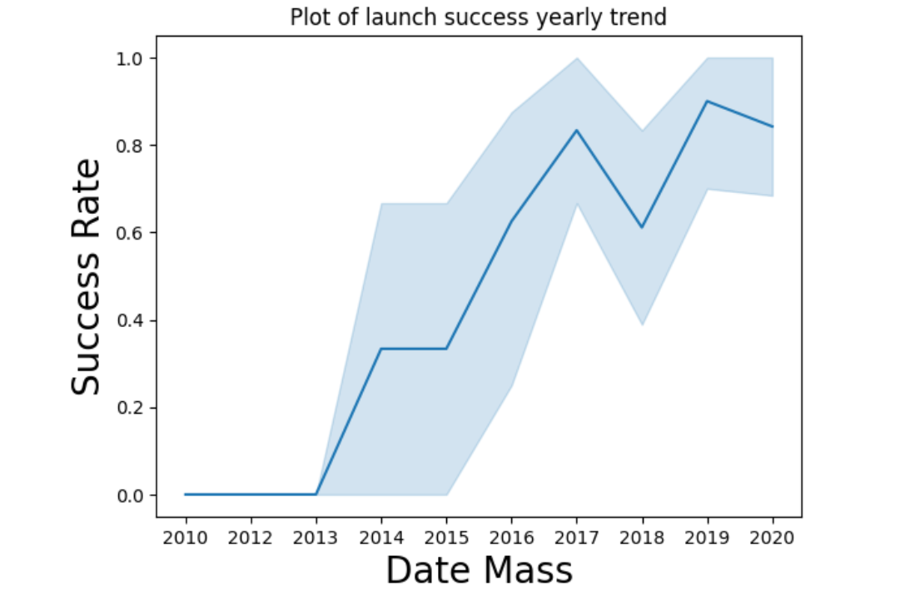
Launch Success Yearly Trend
Explanation:
On analyzing the success rate, there is fall in year 2015 and 2018 from previous year. But the graph increasing since year 2013.

Slide 24
All Launch Site Names
Names of the unique launch sites
Present your query result with a short explanation here
%sql select distinct(Launch_site) from SPACEXTBL
The distinch clause is used to query the unique launch site from table SPACEXTBL
CCAFS LC-40
VAFB SLC-4E
KSC LC-39A
CCAFS SLC-40

Slide 25
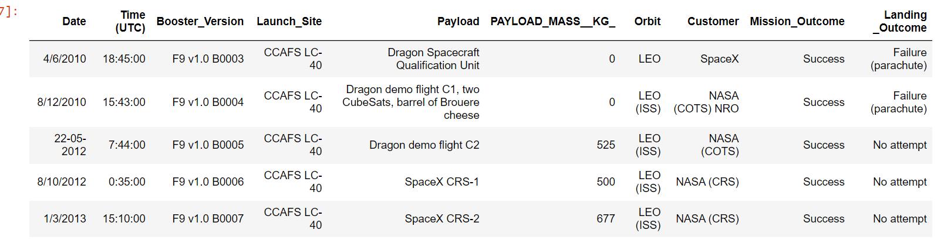
Launch Site Names Begin with 'CCA'
Find 5 records where launch sites begin with `CCA`
Present your query result with a short explanation here
%sql select * from SPACEXTBL where Launch_Site like 'CCA%' limit 5
Using like operator query the launch sites begins with CCA

Slide 26
Total Payload Mass
Total payload carried by booster is 45596
Present your query result with a short explanation here
%sql select sum(PAYLOAD_MASS__KG_) as total_payload_mass from SPACEXTBL where Customer = 'NASA (CRS)’
Select customer as NASA (CRS) and using sum function for PAYLOAD_MASS__KG_ from table SPACEXTBL

Slide 27
Average Payload Mass by F9 v1.1
Calculate the average payload mass carried by booster version F9 v1.1
2928.4
Present your query result with a short explanation here
%sql select avg(PAYLOAD_MASS__KG_) from SPACEXTBL where Booster_Version = 'F9 v1.1’
Using avg function PAYLOAD_MASS__KG is calculated and using clause where for Booster_Version F9 v1.1 from tabe SPACEXTBL

Slide 28
First Successful Ground Landing Date
Find the dates of the first successful landing outcome on ground pad
01-05-2017
Present your query result with a short explanation here
%sql SELECT min(date) from SPACEXTBL where "Landing _Outcome" = "Success (ground pad)“
Using min function for date from table SPACEXTBL and used where clause to filter Landing_Outcome for Success (ground pad)

Slide 29
Successful Drone Ship Landing with Payload between 4000 and 6000
List the names of boosters which have successfully landed on drone ship and had payload mass greater than 4000 but less than 6000
Present your query result with a short explanation here
%sql select Booster_Version, Payload from SPACEXTBL where "Landing _Outcome" = "Success (drone ship)" and (PAYLOAD_MASS__KG_ between 4000 and 6000)
Using where clause and ‘and’ operator for payload mass between 4000 and 6000
Booster_Version | Payload
F9 FT B1022 | JCSAT-14
F9 FT B1026 | JCSAT-16
F9 FT B1021.2 | SES-10
F9 FT B1031.2 | SES-11 / EchoStar 105

Slide 30
Total Number of Successful and Failure Mission Outcomes
Calculate the total number of successful and failure mission outcomes
Present your query result with a short explanation here
%sql select count(Mission_Outcome) as Outcome ,Mission_Outcome from SPACEXTBL group by Mission_Outcome
Use count for the mission outcome and group by mission_outcome from table SPACEXTBL
Outcome | Mission_Outcome
1 | Failure (in flight)
98 | Success
1 | Success
1 | Success (payload status unclear)

Slide 31
Boosters Carried Maximum Payload
List the names of the booster which have carried the maximum payload mass
Booster_Version
F9 B5 B1048.4
F9 B5 B1049.4
F9 B5 B1051.3
F9 B5 B1056.4
F9 B5 B1048.5
F9 B5 B1051.4
F9 B5 B1049.5
F9 B5 B1060.2
F9 B5 B1058.3
F9 B5 B1051.6
F9 B5 B1060.3
F9 B5 B1049.7

Slide 32
Boosters Carried Maximum Payload
Present your query result with a short explanation here
%sql select Booster_Version from SPACEXTBL where PAYLOAD_MASS__KG_ = (select max(PAYLOAD_MASS__KG_) from SPACEXTBL)
Use sub-queries to select max of payload mass from table SPACEXTBL and select booster version using where clause from SPACEXTBL table

Slide 33
2015 Launch Records
List the failed landing_outcomes in drone ship, their booster versions, and launch site names for in year 2015
month | landing_outcome | Booster_Version | Launch_Site
01 | Failure (drone ship) | F9 v1.1 B1012 | CCAFS LC-40
02 | Failure (drone ship) | F9 v1.1 B1013 | CCAFS LC-40
03 | Failure (drone ship) | F9 v1.1 B1014 | CCAFS LC-40
04 | Failure (drone ship) | F9 v1.1 B1015 | CCAFS LC-40
04 | Failure (drone ship) | F9 v1.1 B1016 | CCAFS LC-40
06 | Failure (drone ship) | F9 v1.1 B1018 | CCAFS LC-40
12 | Failure (drone ship) | F9 FT B1019 | CCAFS LC-40

Slide 34
2015 Launch Records
Present your query result with a short explanation here
%sql select substr(Date, 4, 2) as month, (select "Landing _Outcome" from SPACEXTBL where "Landing _Outcome" = "Failure (drone ship)") as landing_outcome, Booster_Version, Launch_Site from SPACEXTBL where substr(Date, 7, 4) = '2015’
Use sub-queries to select failure landing and from which select record where date is 2015 to get failure (drone ship) for year 2015

Slide 35
Rank Landing Outcomes Between 2010-06-04 and 2017-03-20
Rank the count of landing outcomes (such as Failure (drone ship) or Success (ground pad)) between the date 2010-06-04 and 2017-03-20, in descending order
Present your query result with a short explanation here
%sql SELECT "Landing _Outcome", COUNT(*) AS COUNT_LAUNCHES FROM SPACEXTBL WHERE DATE BETWEEN '04-06-2010' AND '02-02-2017’
Using where clause between 04-06-2010 and 02-02-2017 and select count of the record filtered
"Landing _Outcome" | COUNT_LAUNCHES
Landing _Outcome | 0

Slide 36

Section 3

Slide 37
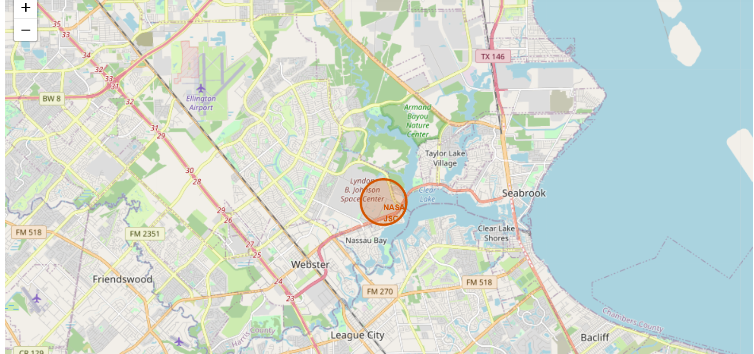
Location of launch site

Slide 38
Location of launch site
Explore the generated folium map and make a proper screenshot to include all launch sites’ location markers on a global map
The above folium map shows the launch site of the rocket.
Explain the important elements and findings on the screenshot
The launch site are in proximity with equator line
All the launch site are close to coast

Slide 39
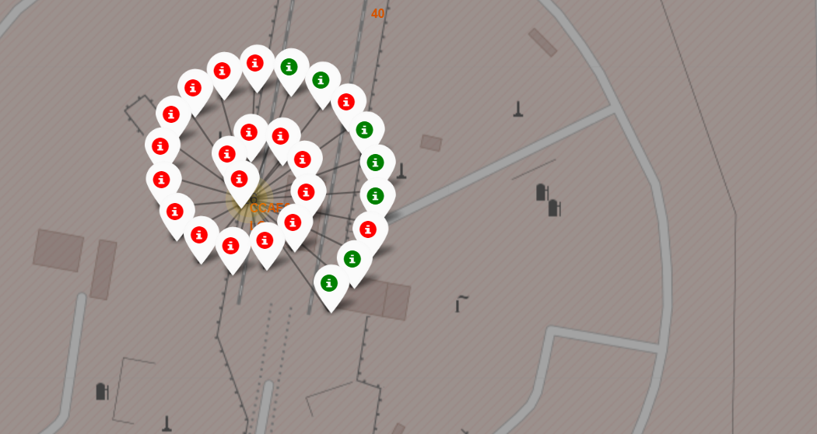
Folium marker
Replace <Folium map screenshot 2> title with an appropriate title

Slide 40
Folium marker
Explore the folium map and make a proper screenshot to show the color-labeled launch outcomes on the map
Green indicated success landing and red indicate the failure of first stage landing
Explain the important elements and findings on the screenshot
KSC LC-39A region has the most success rate and CCAFS SLC-40 region has the most failure rate.

Slide 41
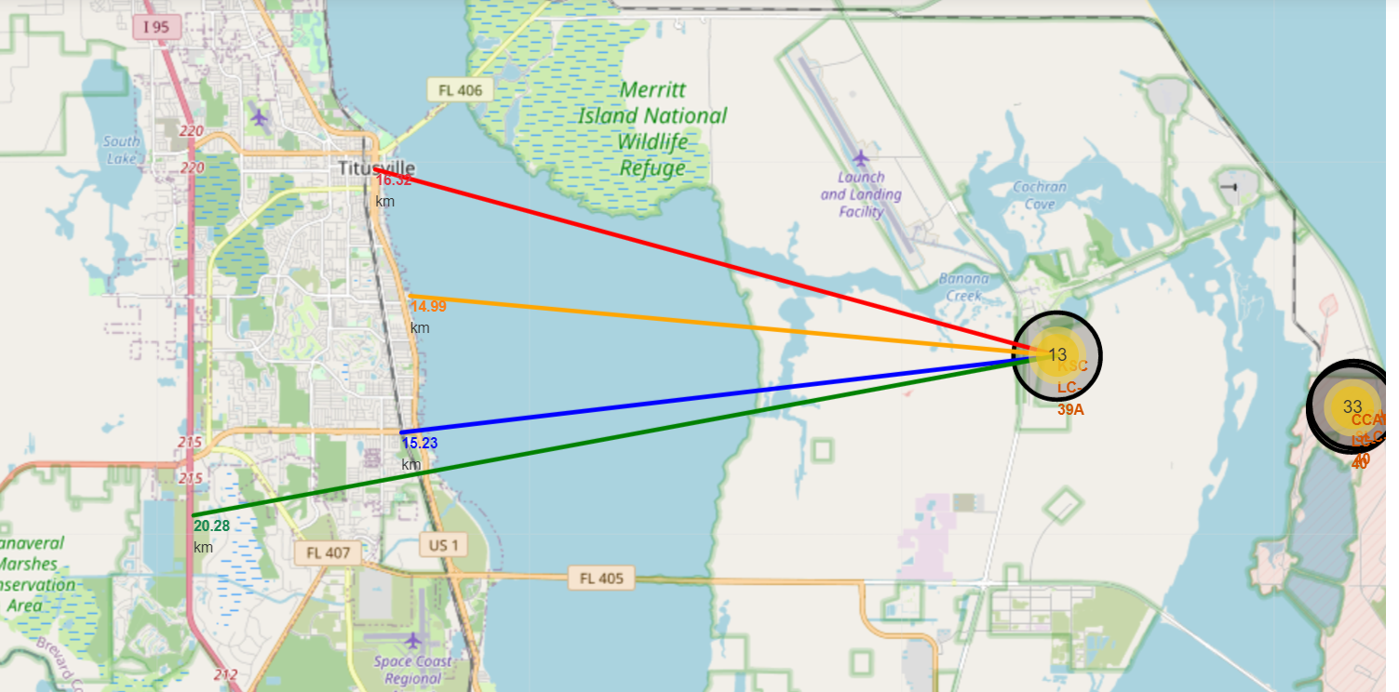
<Folium Map Screenshot 3>
Replace <Folium map screenshot 3> title with an appropriate title

Slide 42
Explore the generated folium map and show the screenshot of a selected launch site to its proximities such as railway, highway, coastline, with distance calculated and displayed
The distance from launch site for railway, highway, coastline are calculated
Explain the important elements and findings on the screenshot
The distance from railway is 15.23 km, the distance from highway is 20.28, the distance from coastline is 14.99km

Slide 43

Section 4

Slide 44
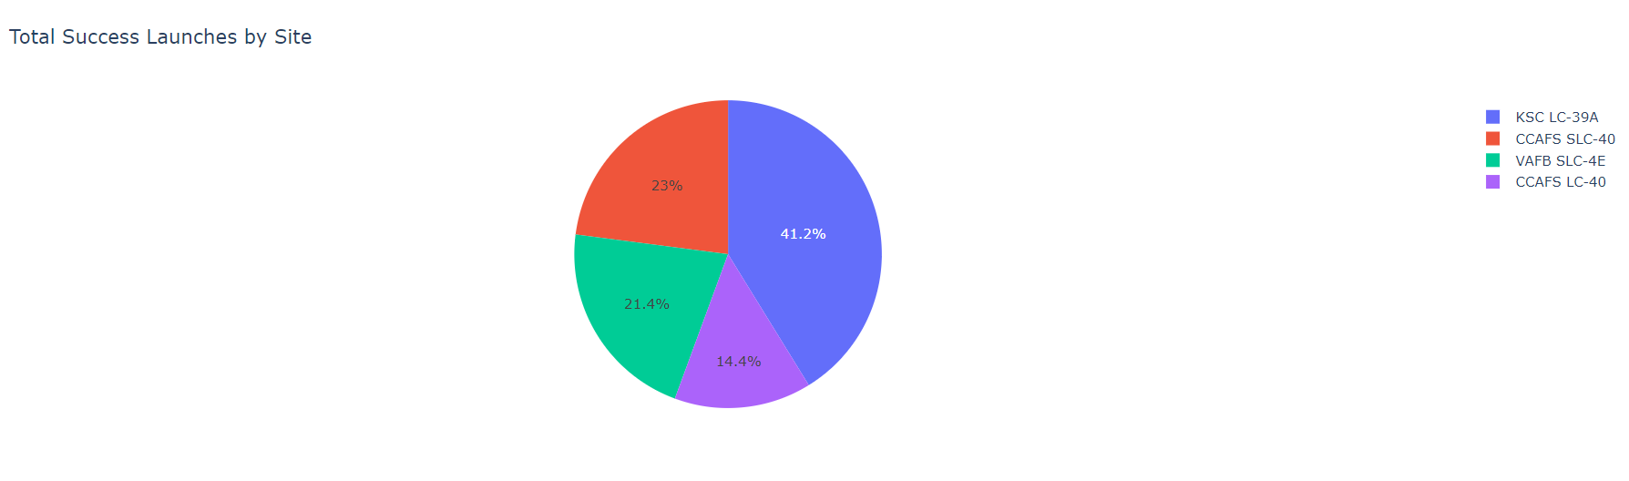
Pie chart for all site
KSC LC-39A is 41.2%, CCAFS SLC-40 has 23%, VAFB SLC-4E has 21.4%, and CCAFS LC-40 has 14.4% success rate.

Slide 45
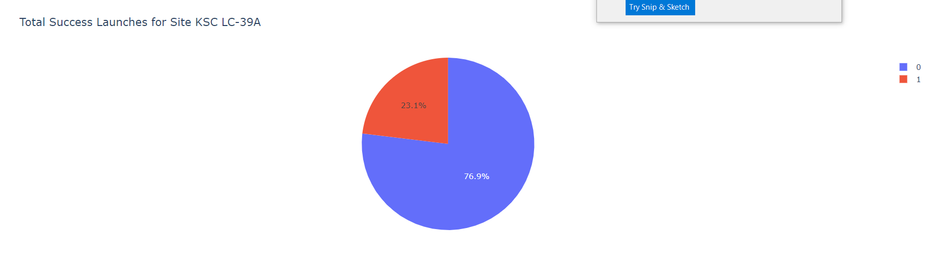
Launch site with highest success rate
KSC LC-39A has 76.9% of success rate.

Slide 46
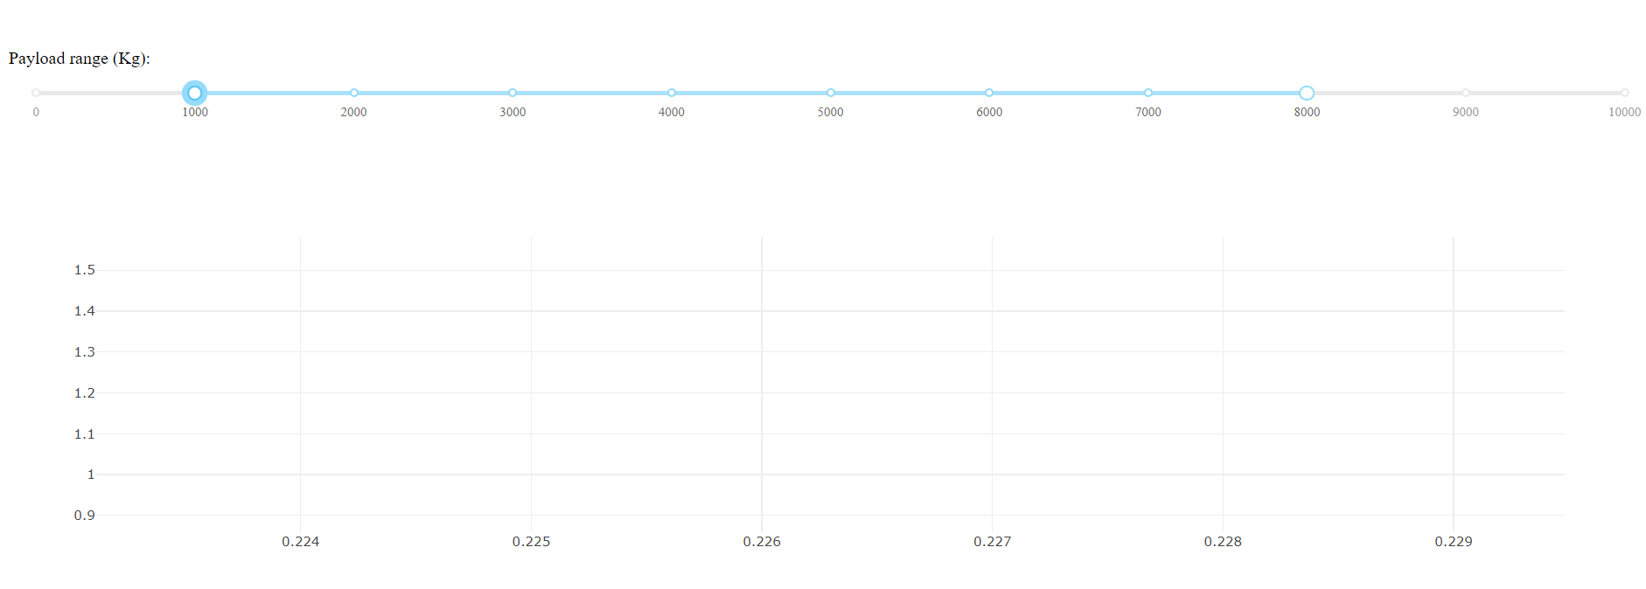
Slider and scatter plot
Slider and scatter plot
The scatter plot shows the slider range between 1000 and 8000.

Slide 47

Section 5

Slide 48
Classification Accuracy
Visualize the built model accuracy for all built classification models, in a bar chart
Find which model has the highest classification accuracy
Model like K-Nearest Neighbor and svm has the highest accuracy score of 83%

Slide 49
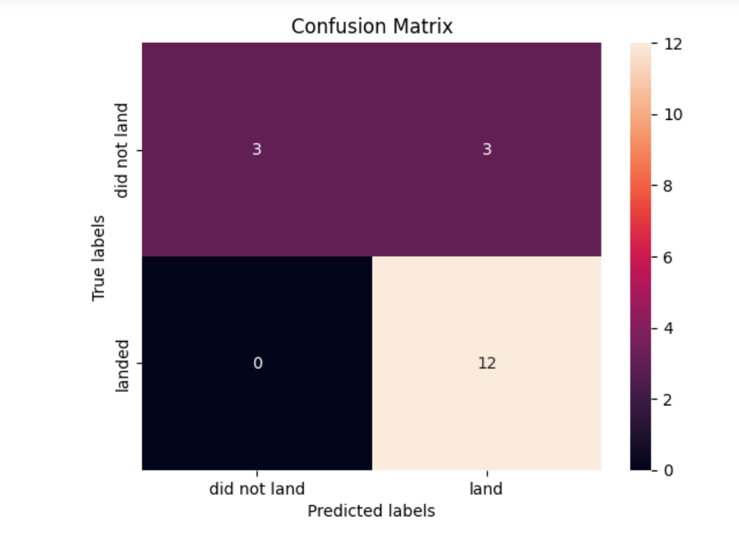
Confusion Matrix
Show the confusion matrix of the best performing model with an explanation

Slide 50
Confusion Matrix
The above confusion matrix is for SVM. True positive are 12 and true negative are 3.
There are 3 false positive and 0 false negative
KNN:
The next confusion matrix is for KNN.
Here True positive is 12 and True negative is 3. False negative is 0 and False positive is 3

Slide 51
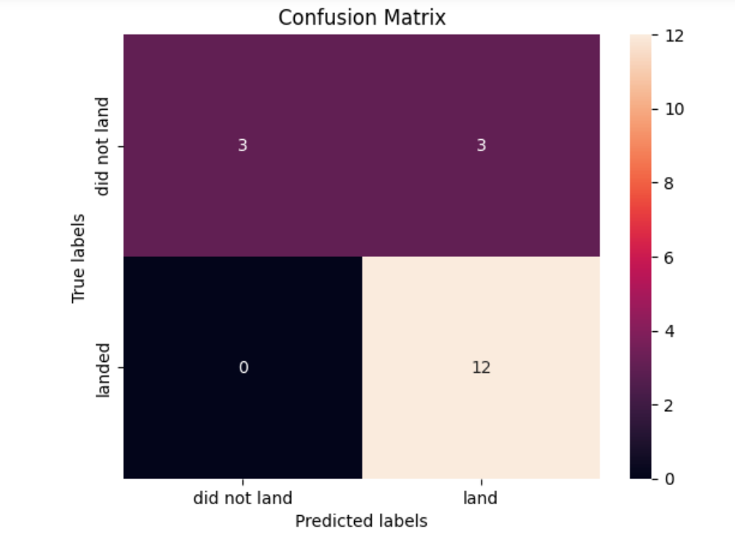
Confusion Matrix

Slide 52
Conclusions
In this project, successful or failure landing of Falcon9 first stage is predicted. Reusing the first stage can save million of dollars.
Determining whether the first stage will be landing successfully or not, it can be used to predict the successful landing for company SpaceY.
Demonstrated the collection of data through web scraping and JSON. In JSON, the data gathered is normalized to convert to table. Using data wrangling, Exploratory data analysis with SQL and visualization the dataset further analyzed, and the relationship is represented as charts.
Using folium, the map of launching site is plot and analyzed various aspect such as how close they are from coastline and railway. Using dash, the interactive map is drawn.
After which machine learning algorithms such as SVM, KNN, regression, and decision tree is used to predict the success or failure of rocket launch. The confusion matrix are plotted and the accuracy of knn and svm are high comparing to other models which will be suitable for predicting ml success rate based on landing outcome.

Slide 53
Appendix
Include any relevant assets like Python code snippets, SQL queries, charts, Notebook outputs, or data sets that you may have created during this project

Slide 54


